Slide 1
IBS-2 Project
ABIJITH PRADEEP

Slide 2
PART 1 – RUBIKS CUBE IMPLEMENTATION
Processing file used:
Cube.pde
Cubie.pde
Face.pde
Controls.pde
The .pde is an extension for processing files

Slide 3
CUBE.pde
import peasy.*;
PeasyCam cam;
int dim = 3;
Cubie[] cube = new Cubie[dim*dim*dim];
String[] allMoves = {"f", "b", "u", "d", "l", "r"};
String sequence = "";
int counter = 0;
boolean started = false;

Slide 4
void setup() {
size(600, 600, P3D);
cam = new PeasyCam(this, 400);
int index = 0;
for (int x = -1; x <= 1; x++) {
for (int y = -1; y <= 1; y++) {
for (int z = -1; z <= 1; z++) {
PMatrix3D matrix = new PMatrix3D();
matrix.translate(x, y, z);
cube[index] = new Cubie(matrix, x, y, z);
index++;
}}}

Slide 5
for (int i = 0; i < 20; i++) {
int r = int(random(allMoves.length));
if (random(1) < 0.5) {
sequence += allMoves[r];
} else {
sequence += allMoves[r].toUpperCase();
} }
for (int i = sequence.length()-1; i >= 0; i--) {
String nextMove = flipCase(sequence.charAt(i));
sequence += nextMove;
}}

Slide 6
String flipCase(char c) {
String s = "" + c;
if (s.equals(s.toLowerCase())) {
return s.toUpperCase();
} else {
return s.toLowerCase();
}
}

Slide 7
void turnX(int index, int dir) {
for (int i = 0; i < cube.length; i++) {
Cubie qb = cube[i];
if (qb.x == index) {
PMatrix2D matrix = new PMatrix2D();
matrix.rotate(dir*HALF_PI);
matrix.translate(qb.y, qb.z);
qb.update(qb.x, round(matrix.m02), round(matrix.m12));
qb.turnFacesX(dir);
}}}

Slide 8
void turnY(int index, int dir) {
for (int i = 0; i < cube.length; i++) {
Cubie qb = cube[i];
if (qb.y == index) {
PMatrix2D matrix = new PMatrix2D();
matrix.rotate(dir*HALF_PI);
matrix.translate(qb.x, qb.z);
qb.update(round(matrix.m02), qb.y, round(matrix.m12));
qb.turnFacesY(dir);
}}}

Slide 9
void turnZ(int index, int dir) {
for (int i = 0; i < cube.length; i++) {
Cubie qb = cube[i];
if (qb.z == index) {
PMatrix2D matrix = new PMatrix2D();
matrix.rotate(dir*HALF_PI);
matrix.translate(qb.x, qb.y);
qb.update(round(matrix.m02), round(matrix.m12), round(qb.z));
qb.turnFacesZ(dir);
}}}

Slide 10
void draw() {
background(51);
if (started) {if (frameCount % 10 == 0) {
if (counter < sequence.length()) {
char move = sequence.charAt(counter); applyMove(move);
counter++; }}}
scale(50);
for (int i = 0; i < cube.length; i++) {
cube[i].show();
}
}

Slide 11
Cubie.pde
class Cubie {
PMatrix3D matrix;
int x = 0;
int y = 0;
int z = 0;
color c;
Face[] faces = new Face[6];

Slide 12
Cubie(PMatrix3D m, int x, int y, int z) {
this.matrix = m;
this.x = x;
this.y = y;
this.z = z;
c = color(255);

Slide 13
faces[0] = new Face(new PVector(0, 0, -1), color(0, 0, 255));
faces[1] = new Face(new PVector(0, 0, 1), color(0, 255, 0));
faces[2] = new Face(new PVector(0, 1, 0), color(255, 255, 255));
faces[3] = new Face(new PVector(0, -1, 0), color(255, 255, 0));
faces[4] = new Face(new PVector(1, 0, 0), color(255, 150, 0));
faces[5] = new Face(new PVector(-1, 0, 0), color(255, 0, 0));
}
void turnFacesZ(int dir) {
for (Face f : faces) {
f.turnZ(dir*HALF_PI);
} }

Slide 14
void turnFacesY(int dir) {
for (Face f : faces) {
f.turnY(dir*HALF_PI);
} }
void turnFacesX(int dir) {
for (Face f : faces) {
f.turnX(dir*HALF_PI);
} }

Slide 15
void update(int x, int y, int z) {
matrix.reset();
matrix.translate(x, y, z);
this.x = x;
this.y = y;
this.z = z;
}

Slide 16
void show() {
noFill();
stroke(0);
strokeWeight(0.1);
pushMatrix();
applyMatrix(matrix);
box(1);
for (Face f : faces) {
f.show();}
popMatrix(); }}

Slide 17
Controls.pde
void keyPressed() {
if (key == ' ') {
started = true;
}
}

Slide 18
void applyMove(char move) {
switch (move) {
case 'f':
turnZ(1, 1);
break;
case 'F':
turnZ(1, -1);
break;

Slide 19
case 'b':
turnZ(-1, 1);
break;
case 'B':
turnZ(-1, -1);
break;

Slide 20
case 'u':
turnY(1, 1);
break;
case 'U':
turnY(1, -1);
break;

Slide 21
case 'd':
turnY(-1, 1);
break;
case 'D':
turnY(-1, -1);
break;

Slide 22
case 'l':
turnX(-1, 1);
break;
case 'L':
turnX(-1, -1);
break;

Slide 23
case 'r':
turnX(1, 1);
break;
case 'R':
turnX(1, -1);
break;
}}

Slide 24
Face.pde
class Face {
PVector normal;
color c;
Face(PVector normal, color c) {
this.normal = normal;
this.c = c;
}

Slide 25
void turnX(float angle) {
PVector v2 = new PVector();
v2.y = round(normal.y * cos(angle) - normal.z * sin(angle));
v2.z = round(normal.y * sin(angle) + normal.z * cos(angle));
v2.x = round(normal.x);
normal = v2;
}

Slide 26
void turnY(float angle) {
PVector v2 = new PVector();
v2.x = round(normal.x * cos(angle) - normal.z * sin(angle));
v2.z = round(normal.x * sin(angle) + normal.z * cos(angle));
v2.y = round(normal.y);
normal = v2;
}

Slide 27
void turnZ(float angle) {
PVector v2 = new PVector();
v2.x = round(normal.x * cos(angle) - normal.y * sin(angle));
v2.y = round(normal.x * sin(angle) + normal.y * cos(angle));
v2.z = round(normal.z);
normal = v2;
}

Slide 28
void show() {
pushMatrix();
fill(c); noStroke();
rectMode(CENTER);
translate(0.5*normal.x, 0.5*normal.y, 0.5*normal.z);
if (abs(normal.x) > 0) {
rotateY(HALF_PI);}
else if (abs(normal.y) > 0) {
rotateX(HALF_PI);}
square(0, 0, 1);
popMatrix(); }

Slide 29
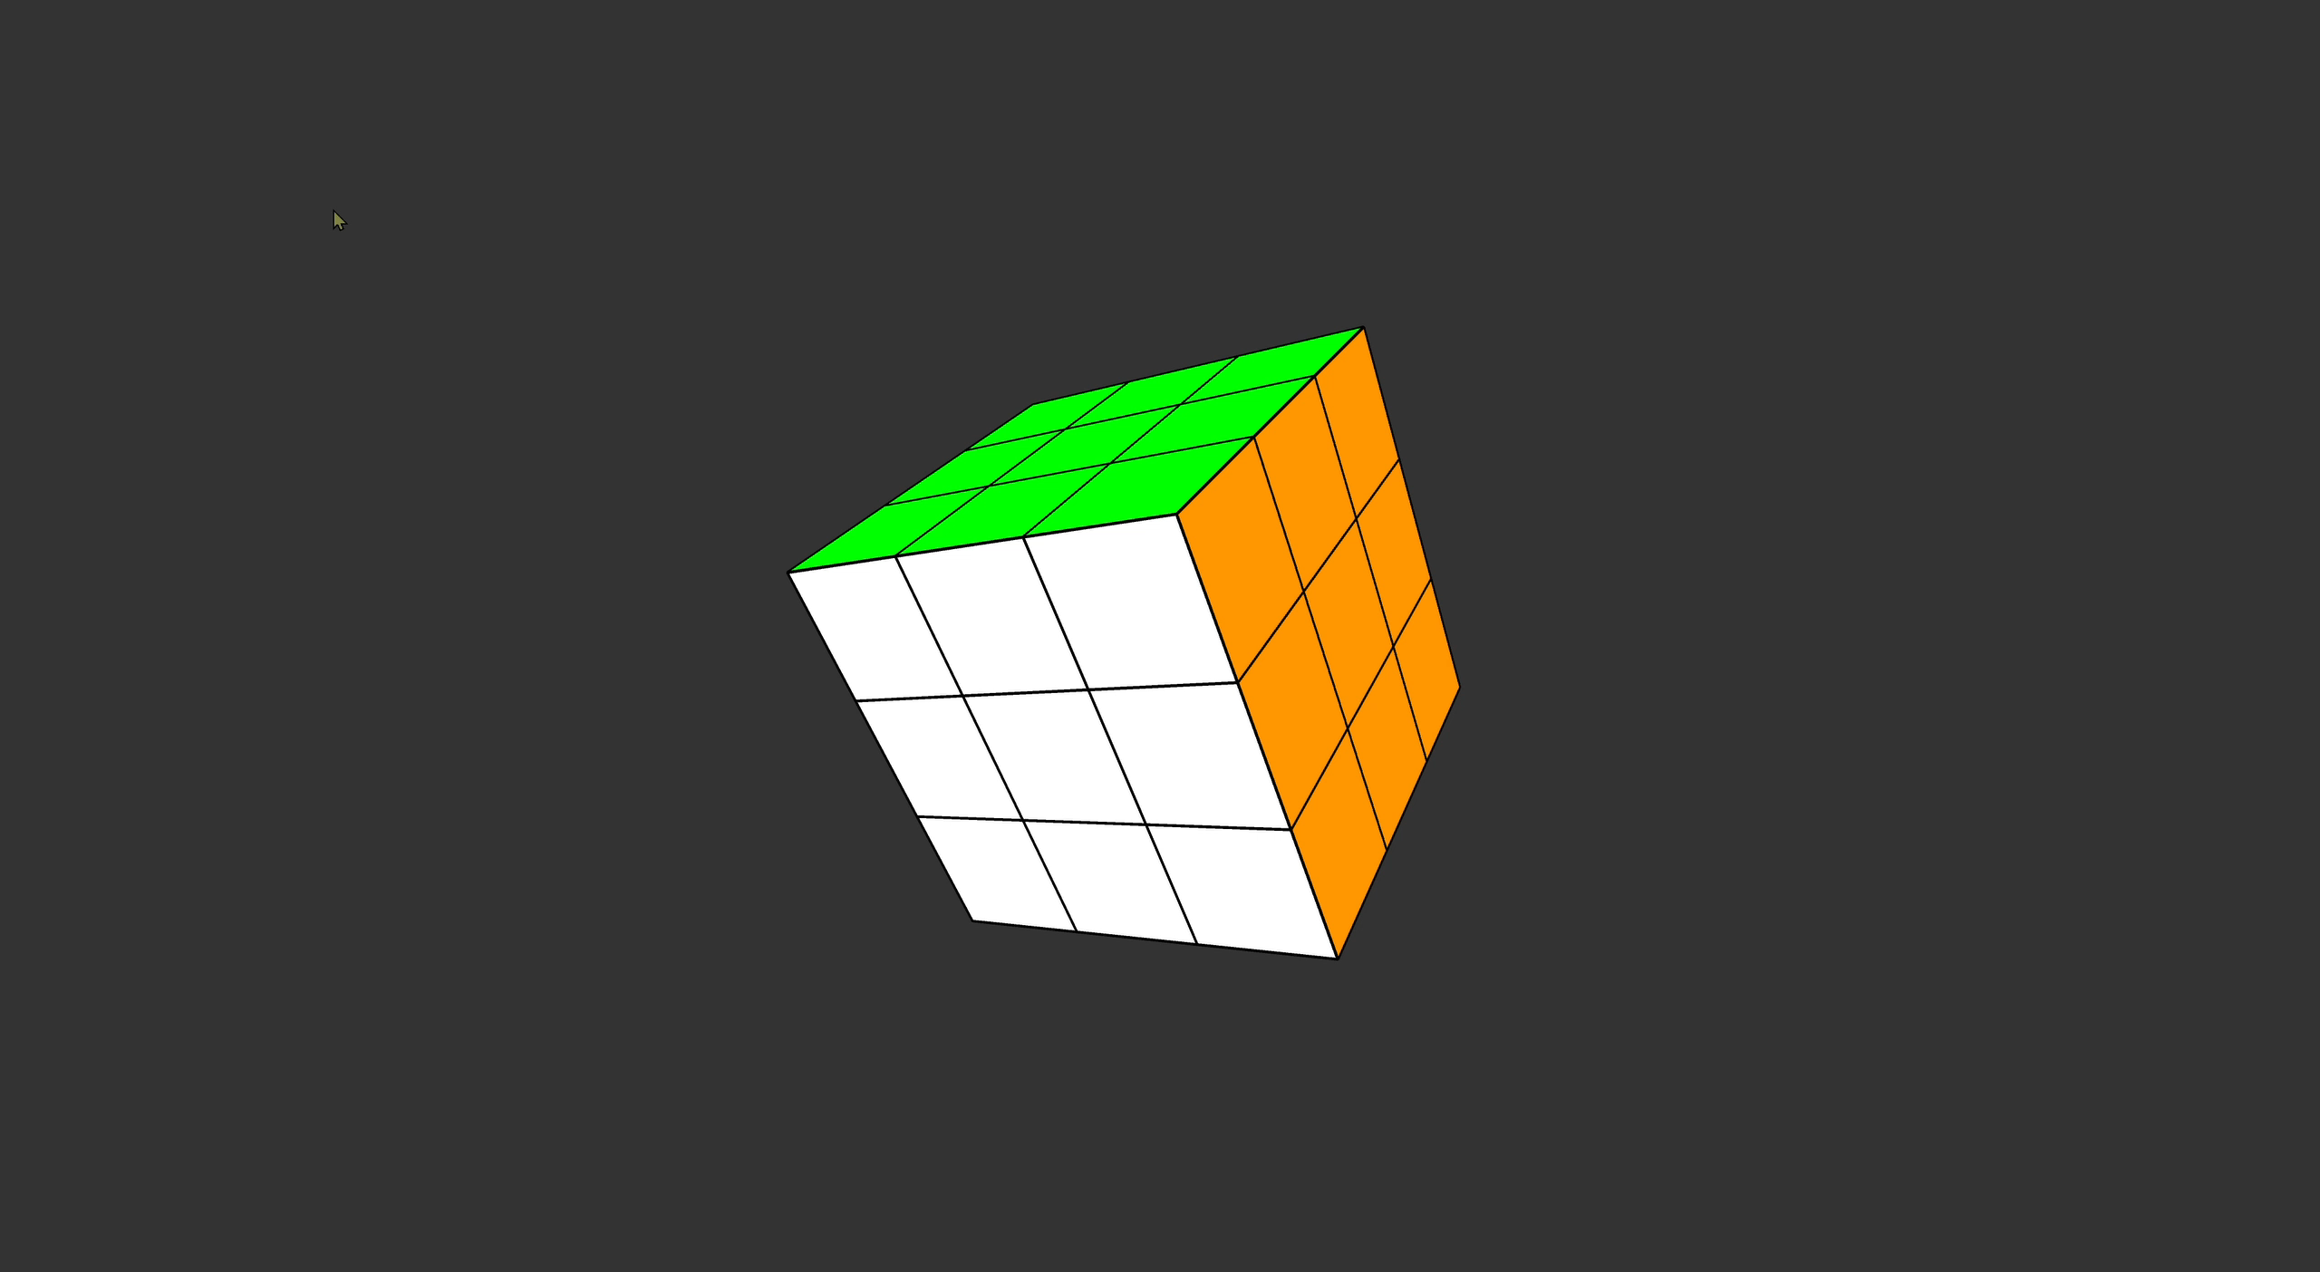
OUTPUT VIDEO

